Slide 1


F fffy
PROJECT REPORT
TOPIC – CUSTOMER RETENTION CASE
STUDY ANALYSIS
SUBMITTED BY - AMAN KUMAR PATEL

Slide 2
(E-retail factors for customer activation and retention: A case study from Indian e-commerce customers)

Slide 3
ACKNOWLADGEMENT
I would like to express my sincere thanks of gratitude to my Mentors from Data Trained academy and Flip Robo company for letting me work on this project. Their suggestions and directions have helped me in the completion of this project successfully.
Finally, I would like to thank my family and friends who have helped me with their valuable suggestions and guidance and have been very helpful in various stages of project completion. Without their support it would be impossible to pursue my internship and PG course.

Slide 4
TABLE OF CONTENT
Introduction
• Business Problem Framing
• Conceptual Background of the Domain Problem
• Review of literature
• Motivation for the Problem Undertaken
2. Analytical Problem Framing
• Mathematical/ Analytical Modelling of the Problem
• Data Sources and their formats
• Data Pre-processing Done
• Hardware & Software Requirements & Tools Used
3. Model/s Development and Evaluation
• Identification of possible problem-solving approaches (methods)
• Visualizations

Slide 5
4. Conclusions
• Key Findings and Conclusions of the Study
• Learning outcomes of the study in respect of data science
• Limitations of this work and Scope for Future Work

Slide 6
introduction
With the rapid global growth in electronic commerce (ecommerce), businesses are attempting to gain a competitive advantage by using ecommerce to interact with customers. Retaining customers in highly competitive business environments is critical for any company’s survival because a lost customer represents more than the loss of the next sale. The company might lose all future sales and profits from that customers’ lifetime of purchases. Nowadays, online shopping is a fast-growing phenomenon. Growing numbers of consumers shop online to purchase goods and services, gather product information or even browse for enjoyment. Online shopping environments are therefore playing an increasing role in the overall relationship between marketers and their consumers. That is, consumer purchases are mainly based on the cyberspace appearance such as pictures, images, quality information and video clips of the product, not on the actual experience. Due to this internet penetration, customers can just sit at their home, place their orders, pay via credit card, and wait until the goods are delivered to their home and they can easily shop their needy products via ecommerce rather than in physical stores.

Slide 7
Business Problem Framing:
The online purchasing rate increasing day by day. Customers’ satisfaction is most important for any business development. The first question that comes into our mind is “What individual factors motivate a buyer to purchase online as well as restrain to purchase online?”. We will discuss about this in data analysis part. The main aim of this project is to explore consumer perceptions of internet-based e-retailing. Customer satisfaction has emerged as one of the most important factors that guarantee the success of online store; it has been posited as a key stimulant of purchase, repurchase intentions and customer loyalty. A comprehensive review of the literature, theories and models have been carried out to propose the models for customer activation and customer retention. Five major factors that contributed to the success of an ecommerce store have been identified as: service quality, system quality, information quality, trust and net benefit. The research furthermore investigated the factors that influence the online customers repeat purchase intention. The combination of both utilitarian value and hedonistic values are needed to affect the repeat purchase intention (loyalty) positively. The data is collected from the Indian online shoppers. Results indicate the e-retail success factors, which are very much critical for customer satisfaction

Slide 8
Conceptual Background of the Domain Problem:
The problem statement examined how customers form expectations on technology based self-service quality and suggested five main attributes of ecommerce store quality, that are service quality, system quality, information quality, trust and net benefit. The result of the study shows that, ease of use and enjoyment were also significant determinants of service quality, while speed of delivery and reliability had positive impact on service quality. Many businesses focus on customer loyalty programs to remain competitive in today's marketplaces and explore innovative ways to keep their existing customers engaged. Customer retention is a simple concept. Yet, it often requires effort from every department to improve the customer experience and build lasting trust. So, what is customer retention and why it is so important. Let’s know about it.
Review of literature:
This literature review is the integrated form of relationship marketing, customer loyalty, trust, reliability and privacy policy concept because all of these concepts are inter linked with each other. The customer retention is possible only when the organization fulfil customers’ needs and their expectations. A buyer goes through five stages while making a decision to purchase like problem recognition, information search, evaluation of alternatives, purchase decision,.

Slide 9
These stages are best explainable when a buyer goes for buying costly items on online stores, such as a diamond jewelry, home appliances etc. However, in dayto-day purchase, consumers may not go through all these stages, since some commodes do not need information, and based on buyer’s previous experience they will visit a store for the purchase. In addition, companies are now using the Internet to build closer relationships with consumers and marketing partners. Besides competing in traditional marketplaces, they now have access to exciting new market spaces. Moreover, through the internet, consumers can learn about design, order, and pay for products and services, without ever leaving home and then, through the wonders of express delivery, they can receive their purchases in short time. From virtual reality displays that test new products to online virtual stores that sell them, the technology explosion is affecting every aspect of marketing. The internet has now become a truly global phenomenon. Consumer’s satisfaction and purchase decision on online shopping depends on few more issues. These are, e-store image, delivery and customers services, service quality and purchase behavior personalization, motivations for online purchase, trust, reliability, privacy, transaction and cost, incentive programmers, web-site design, online interactivity, merchandise motivation, assurance, convenience, responsiveness etc. Following from the above consideration, this project will find out what individual factors motivate a buyer to purchase online and restrain to

Slide 10
Motivation for the Problem Undertaken:
The main objective behind this problem is to help the ecommerce websites to find the e-retail factors for customers activation and retention. The online shopping was considered by almost everyone to be convenient. The store is always open and it is easy, less stress and time saving to shop from home. Participants also seemed to agree that internet shopping gives access to a large range of stores and products from the entire world and offers best price to their consumers. So, in this project we will be analyzing how these online stores attract the customers and whether the customers satisfied by their products or not.
ANALYTICAL PROBLEM FRAMING
Mathematical/ Analytical Modelling of the Problem:
The main thing that I found in problem statement is, the data given for us is unsupervised data. The problem statement contains both utilitarian value and hedonic value. I have performed both univariate and bivariate analysis to analyze these values using different plots like pie plot, count plot, distribution plot, factor plot etc. These plots give better pattern for analyzing the data.

Slide 11
Data Sources and their formats:
✓ The data is collected from the Indian online shoppers. Results indicate the e-retail success factors, which are very much critical for customer satisfaction. The dataset is provided by Flip Robo which is in the format xlsx.
✓ There are two excel sheets one is detailed datasheet and other one is encoded datasheet. I have used detailed datasheet for the processing.
✓ The dataset contains 269 rows and 71 columns which is comprised of categorical columns. All the features contain object data type except the feature Pin code (integer data type).
✓ While describing the data I found skewness and outliers present in the columns. Since all the columns are categorical so I haven’t removed outliers and skewness.

Slide 12
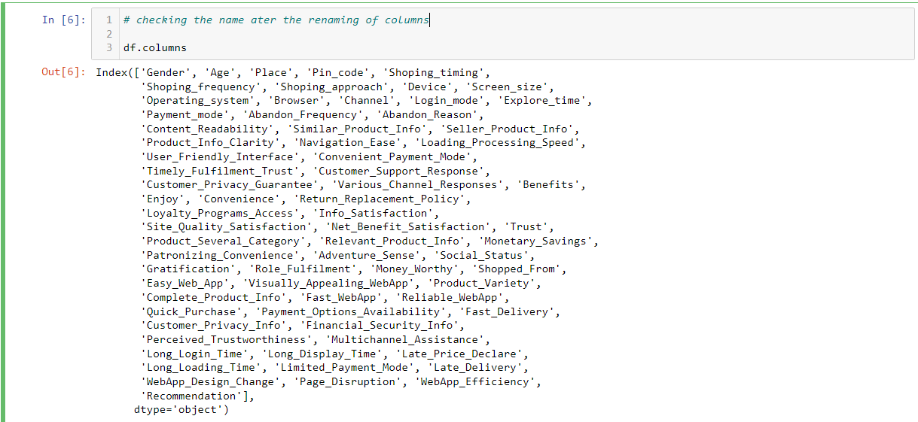
Data Pre-processing Done:
➢ Firstly, I have imported the necessary libraries and dataset.
➢ Checked the dimension of the dataset, data types of the features. Checked the information of the data frame using info () and checked the number of unique values present in the dataset.
➢ Since the columns had no proper names, so I renamed them with new name as below.

Slide 13
➢ I have checked the null values and found no null values present in the dataset and visualized it using heat map.
➢ Checked the value count of each column. By checking value count function, I found some of the columns contains duplicate and unwanted entries, so I have replaced them using appropriate values.
➢ Visualized each feature using seaborn and matplotlib libraries by plotting count plot, pie plot, distribution plot, box plot and factor plot.
➢ Performed label encoding.
➢ Checked the skewness and outliers. Since all the columns are categorical, so I haven’t removed skewness and outliers.
➢ Checked the correlation between the features and visualized it using heat map.
➢ Described the data using describe ().

Slide 14
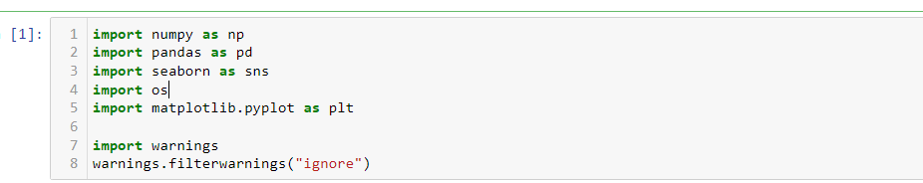
Hardware & Software Requirements & Tools Used:
Hardware required:
• Processor: core i5 or above
• RAM: 8 GB or above
• ROM/SSD: 250 GB or above Software required:
• Anaconda 3- language used Python 3
• Microsoft Excel Libraries: The important libraries that I have used for this project are below.

Slide 15
MODEL/S DEVELOPMENT AND EVALUATION
Identification of possible problem-solving approaches (methods):
✓ I have used “replace ()” function to replace unwanted entries in the columns.
✓ Used “Label Encoder” method to encode the categorical features into numerical.
✓ Described the statistical details of the features using “describe ()” method.
✓ Used “Pearson’s method” to check the correlation between the features.
✓ Performed both univariate and bivariate analysis using seaborn and matplotlib
Visualizations: I have performed both univariate and bivariate analysis to visualize the data. In univariate analysis I have used pie plots, count plots and distribution plot and in bivariate analysis I have used count plot, factor plot and boxplots. Here I will be showing only bivariate analysis plots to analyze the data.

Slide 16
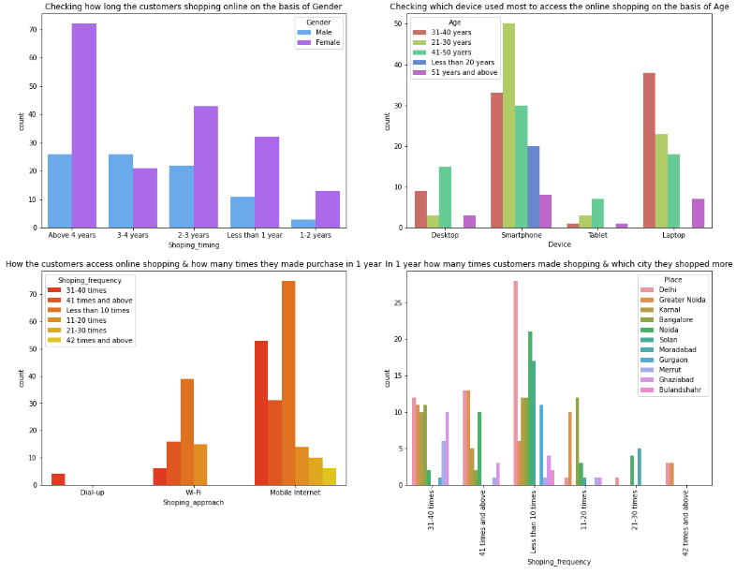

Slide 17
Observation :
Many customers whose age between 31-40 years and 21-30 years used Smartphones followed by Laptops to access the online shopping websites.
Most of the customers access the shopping websites more than 31-40 times in 1 year through Mobile Internet to shop the products also most of the customers who used mobile internet to access the online shopping website made online purchase less than 10 times in a year. And only few of the customers used WiFi network to access the shopping store.
Most of the customers used ecommerce websites less than 10 times in a year from the city Delhi to shop the products

Slide 18
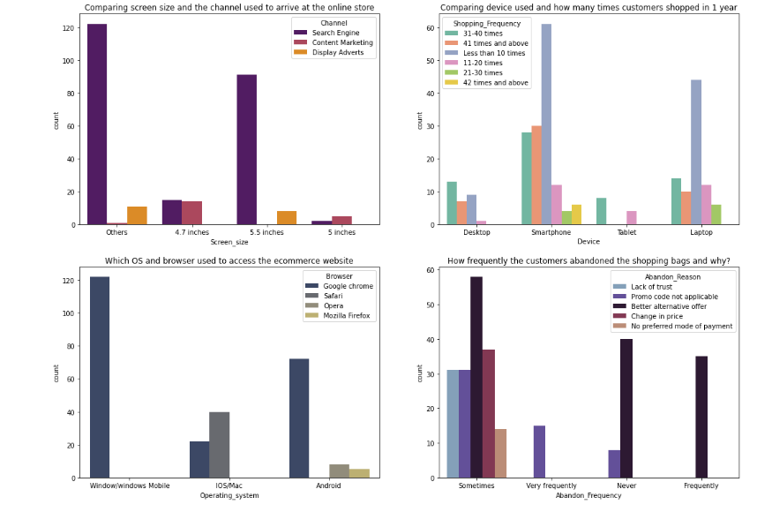

Slide 19
observation =
The customers having their mobile screen size say 6 inches(others) have followed search engine channel to arrive at their favorite online store for the first time. Also the customers who have their screen size 5.5 inches also used search engine channel to access the online shopping store.
Most of the customers used Smartphones 31-40 times in an year to access the ecommerce websites to shop the products.
Many customers having windows operating system in their device ran Google chrome to access the ecommerce shopping websites and some of the customers having IOS/Mac operating system used Google chrome as well as Safari to reach the online shopping store.
Due to Lack of trust on the ecommerce websites, sometimes most of the customers abandoned the websites and some of the customers abandoned the shopping website due to the promo code not applicable. which means, if the product is having the special price or some catalogue price rule is applicable on it.Then coupon code should not be applicable on the products.

Slide 20
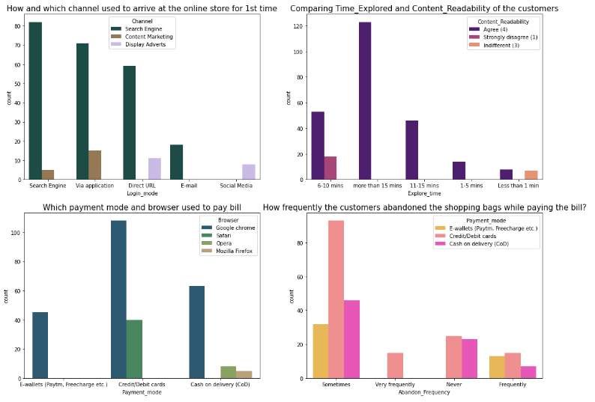

Slide 21
Observations
Search engine is the most used channel by the customers to arrive their favourite store for the first time and after visit the website for the first time, most of them used the same channel to reach the online retail store to reshopping the products.
Most of the customers agreed that the content on the website is easy to read and understand also they explored more than 15 mins before making the purchase decision and some of the customers strongly disagreed that the content is not good and they explored 6-10 mins before making the purchase decision. So ecommerce websites should enable some images and it should contain clear structure, so that the customers can easily read and understand the content of the product.
Most of the customers used google chrome to reach the websites and they preferred to pay their product price using Credit/Debit cards and only few of the customers used Safari browser to reach the e-retail websites. Sometimes the customers used to abandon their selected items and wants to leave without making payment and most of them making the payment using E-wallets methods.

Slide 22
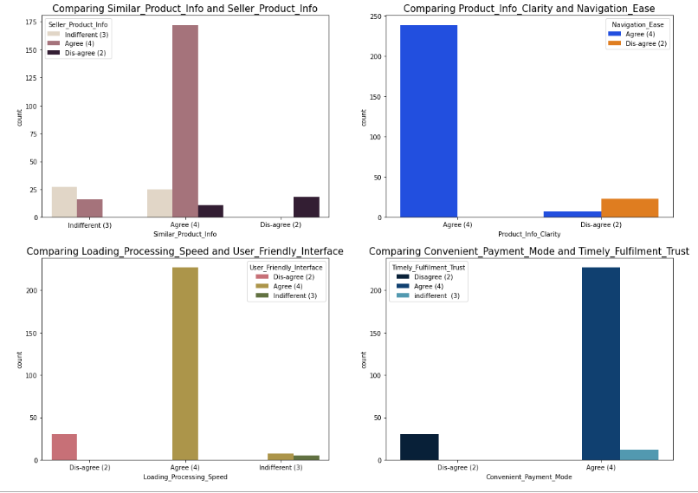

Slide 23
observation
Most of the customers agree to the trust that the online retail stores will fulfil its part of the transaction at the stipulated time also most of them very happy with the convenient payment modes given by the websites. In other words, the websites must provide all the possible ways of payment methods then only the customers shop frequently all the time the mode of the payment for customers may not possible sometimes they may choose cash on delivery. So if the retailers provides all type of payment methods then the customers can easily make the payment also it enhances the sales of the ecommerce sites. And the transaction must also be given with some stipulated time otherwise the payments may be failed so they've to provide minimum amount of time which need to be fixed for all.

Slide 24
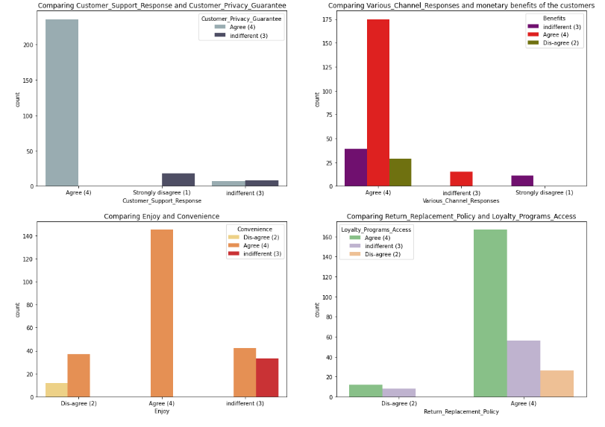

Slide 25
observation =
Most of the customers agreed that return and replacement policy of the e-tailer is important for purchase decision also gaining access to loyalty programs is a benefit of shopping online. Many return policies have conditional agreements, such as time limits, that must be clearly defined and expressed at the time of purchase or else the customers won't get the chance to return their damaged or dissatisfied products due to this they may not access the same website if they want to shop again. It is evident from the fact that the customers actually not liking the products completely, they are just purchasing the products and returning them in case of any dissatisfaction. So it is important for the online shopping websites to make easy return and replacement policy if they want to retain their customers. Also, by gaining access to loyalty programs, the customers get more and more rewards, increasing their engagement rate and thus bringing more profit to both company and customer.

Slide 26
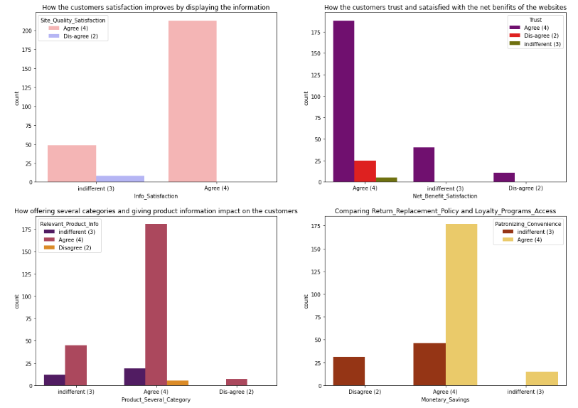

Slide 27
observation
Most of the customers agreed that net Benefit derived from shopping online can lead to users’ satisfaction also they believe that user satisfaction cannot exist without trust. The e-tailer should provide crediting points (net benefits) so that the customers tend to buy frequently in order to gain points. Trust is also a major factor for customers to decide whether to buy products from online stores or not also trust helps reduce uncertainty when the degree of familiarity between the customer and transaction security mechanism is insufficient. If customers have a high level of trust toward the website, it is more likely for them to have intention to purchase so it’s important for the ecommerce website to make the customers get trust on them. The customers are more likely to purchase on the same websites if that website offers them a wide variety of products in several category and giving relevant information about the products. Having multiple product lines may allow to grow the ecommerce business and finding accurate and up-to-date information of the product must be stated clearly in the website so that the customers can buy the products without any confusion. In this digital and competitive world, everyone wants to save money, the ecommerce company need to know that the best way to sell online is to make the consumer feel that he is saving money doing so. And not just feel, online shopping should result in a lot of saving for the consumer. This saving would automatically get converted into trust and brand equity for the seller. To do this the online companies should offer the best deals and bargains to the consumer through social platforms. If the retailers give some discounted prices then the customers can make money savings and they tend to purchase in the same websites regularly. Convenience is the important thing for ecommerce and most of the customers agreed with it.

Slide 28
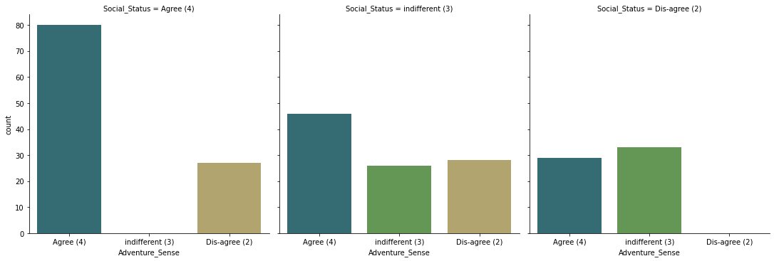

Slide 29
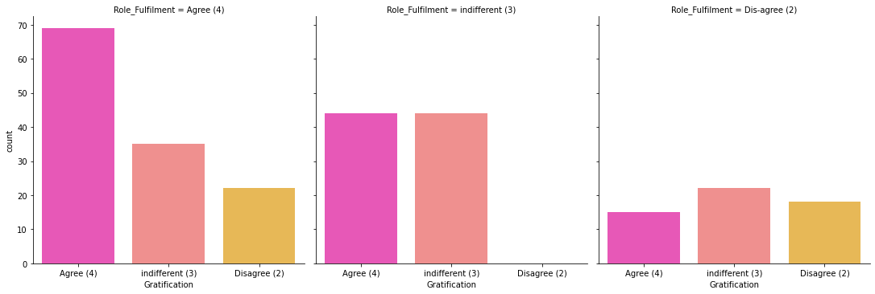

Slide 30
observation
Most of the customers agreed that they felt gratified while shopping on their favourite e-tailer. This is because the e-tailer companies can successfully make up for a mistake or a dissatisfied customer is to be equally expedient in addressing the customer’s needs. Also, most of the customers agreed that shopping on online website helps them fulfil their certain roles. Fulfilment refers to activities that ensure customers receive what they ordered, including the time of delivery, order accuracy, and delivery condition, also the customers cannot see the product directly before they purchase it. Companies must ensure delivery timeliness, order accuracy, and delivery conditions to provide superior service quality for customers. The companies must understand that the customer satisfaction is an indication of the customer's belief of the probability of a service leading to a positive feeling. If the companies give positive vibration to the customers by giving chance to fulfil their roles then they shop more on that particular website.

Slide 31
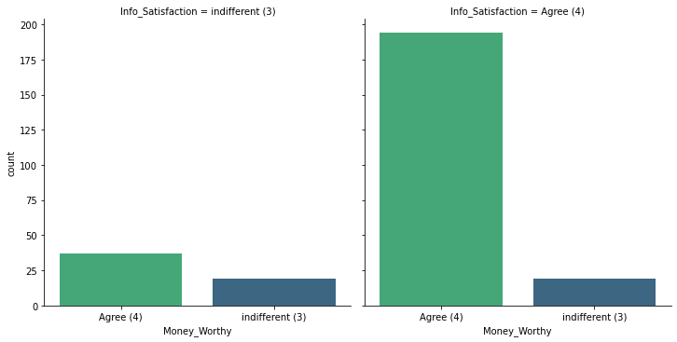

Slide 32
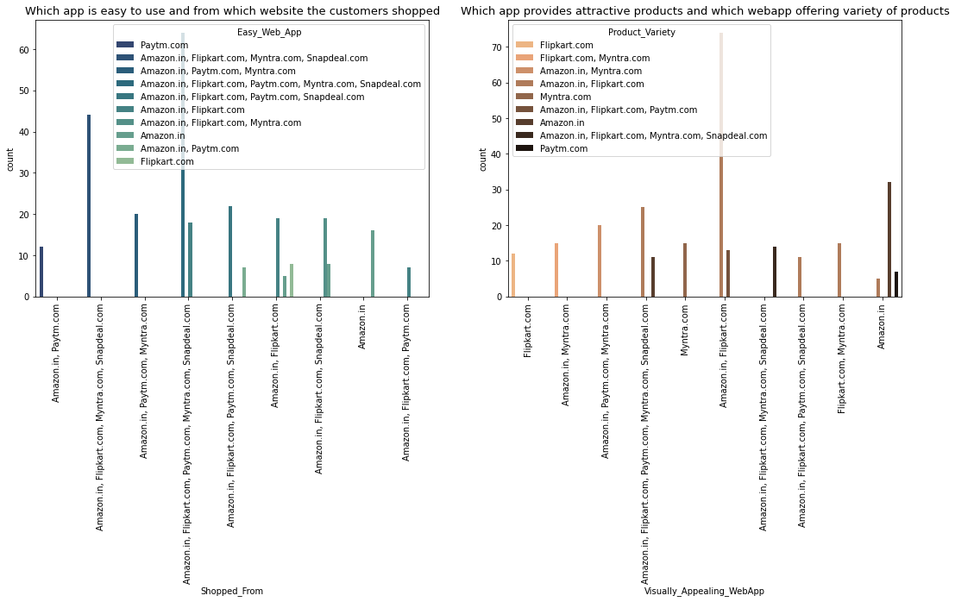

Slide 33
Observations:
There are many websites for selling the products among them Amazon.in, Flipkart.com, Paytm.com, Myntra.com, Snapdeal.com are easy to use and shop.
Most of the customers used these websites more, this is because, these websites may provide less price products, good discounts and may have lots of varieties of similar products with different brand. Amazon and Flipkart have high visual appealing web-page layout compared to others that means these websites provides some colourful graphics on the homepage. The more people find the website attractive, there are higher chances that they will stay a little longer in that website, also these websites provide wild variety of products in an attractive manner which makes the customers to buy the product.

Slide 34
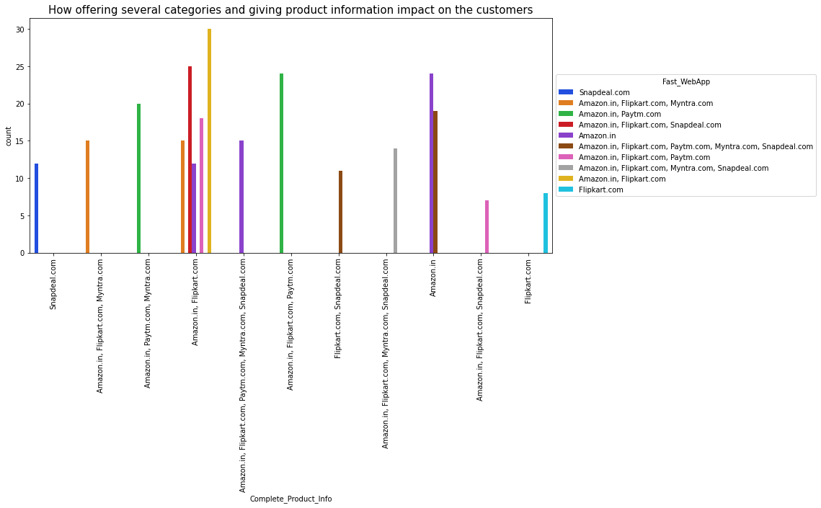

Slide 35
observation
The most common problem which is faced by the customers is server problem, in many websites these problems are common. Also, only few websites provide the relevant information about the products. These things may lead the customers to have bad impression on these websites. From the plot we can visualize that the amazon and flip kart websites gives complete and relevant information and these websites have no issue with the server and most of the customer liked the web speed of both amazon and flip kart.

Slide 36
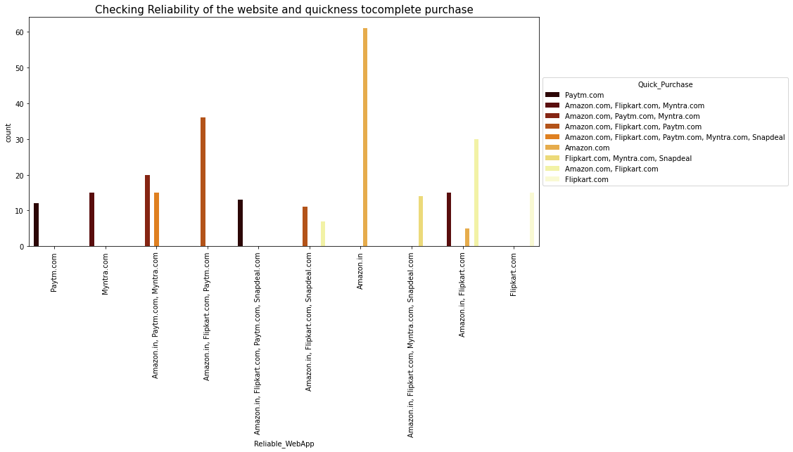

Slide 37
Observation
The consumer determines the shop’s reliability based on the information transmitted by the shop and certain sites offer customers the opportunity to purchase items that are used which means they are likely to be the most reliable.
Some of the customers completes their purchase very quickly due to the discount, less price, free delivery charges etc provided by the ecommerce websites. From the plot we can notice amazon site is more reliable and most of the customers complete their purchase on amazon very quickly.

Slide 38
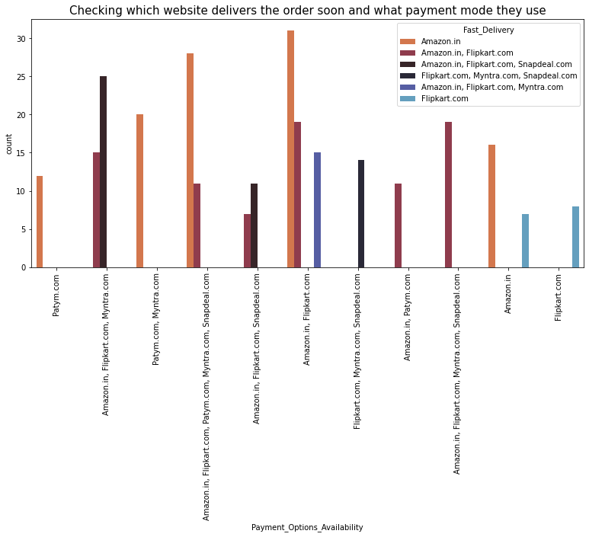

Slide 39
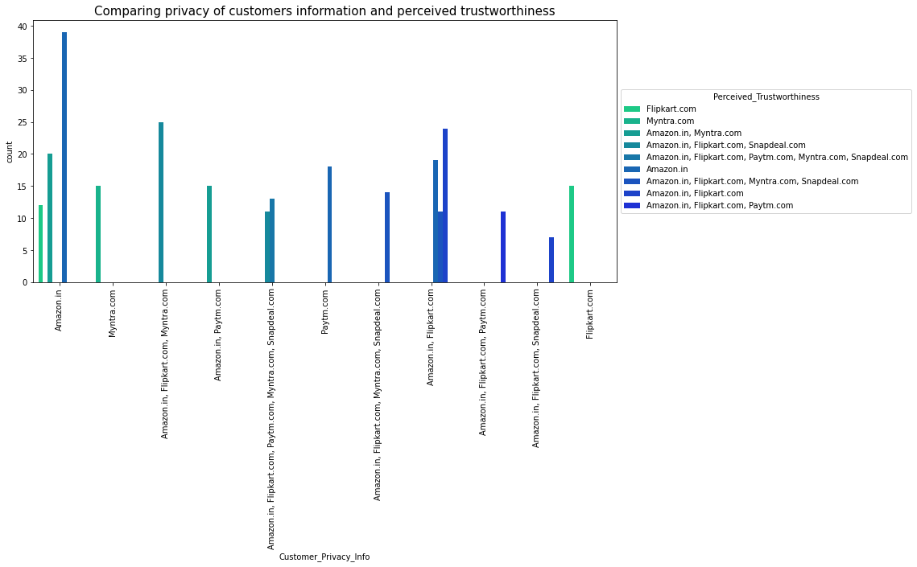

Slide 40
observation
Most of the customers trusts amazon followed by flip kart in terms of keeping their privacy of data information secured and the customers who believes that amazon website keeps their financial information as secrete also trusts flip kart, Myntra, Snapdeal and Paytm in terms of keeping their financial information secured.
Most of the customers believed that Amazon has perceived trustworthiness compared to others. Apart from this, customers believed that flip kart and Myntra also have perceived trustworthiness.

Slide 41
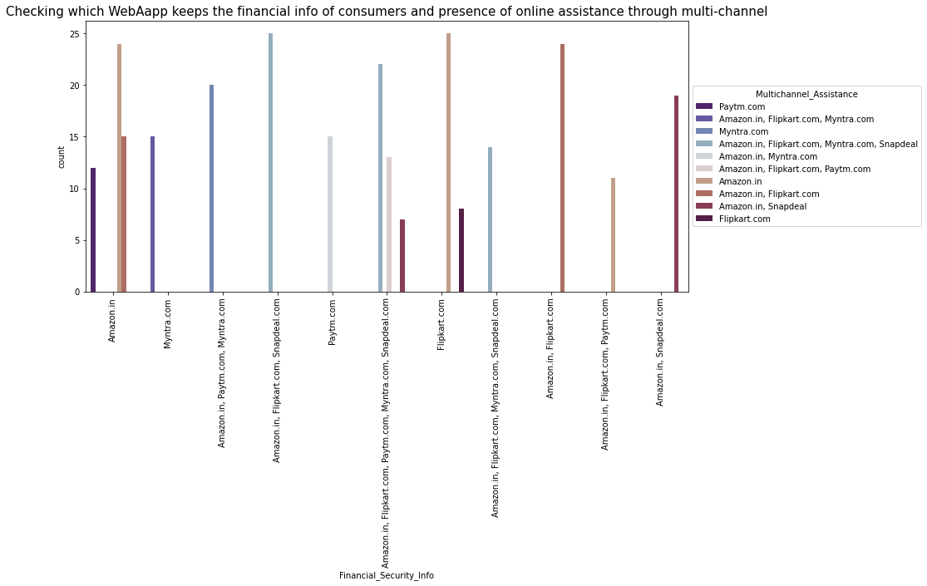

Slide 42
Observation
The customers trusts that amazon and flip kart keeps their financial information private and they never share any type of information to others. Multi-channel retailing provides several benefits which includes several shoppers like the convenience that is provided through online channels in comparison to physical stores.
Most of the customers like Amazon in terms of presence of online assistance through multi-channel.

Slide 43
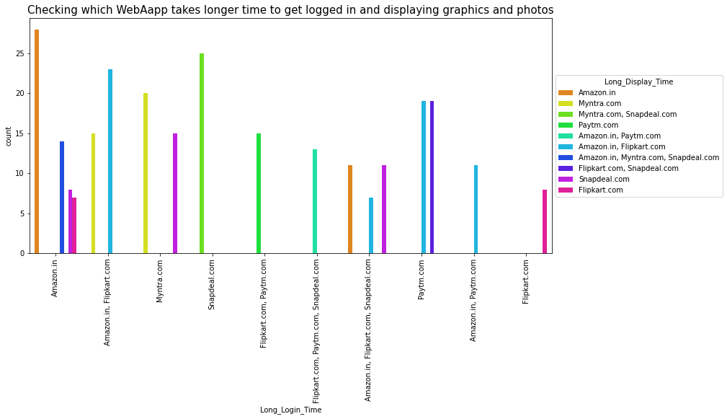

Slide 44
observation
The customers mostly choose amazon website for buying products as it gives promotions and sales periods in some days, on these days most of the customers attracted by the offers provided by the websites, wants to buy the products. So, amazon will take more time to allow the customers to get login into the site. When there is promotion or sales period, amazon and Myntra takes longer time to display the graphics and photos.

Slide 45
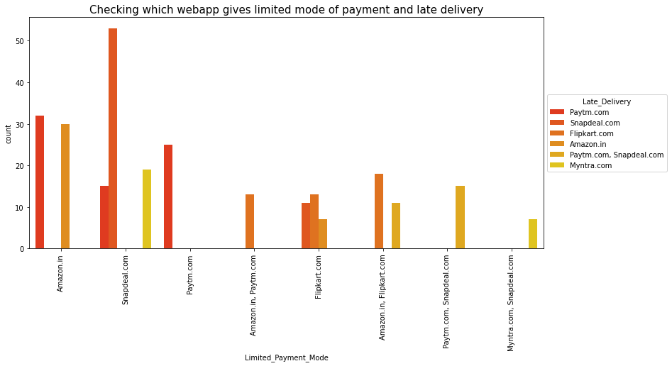

Slide 46
observation
Snapdeal has limited mode of payment on most of the products followed by Amazon. And paytm takes more time to deliver the product. So this website may not satisfy the customers due to late delivery.

Slide 47
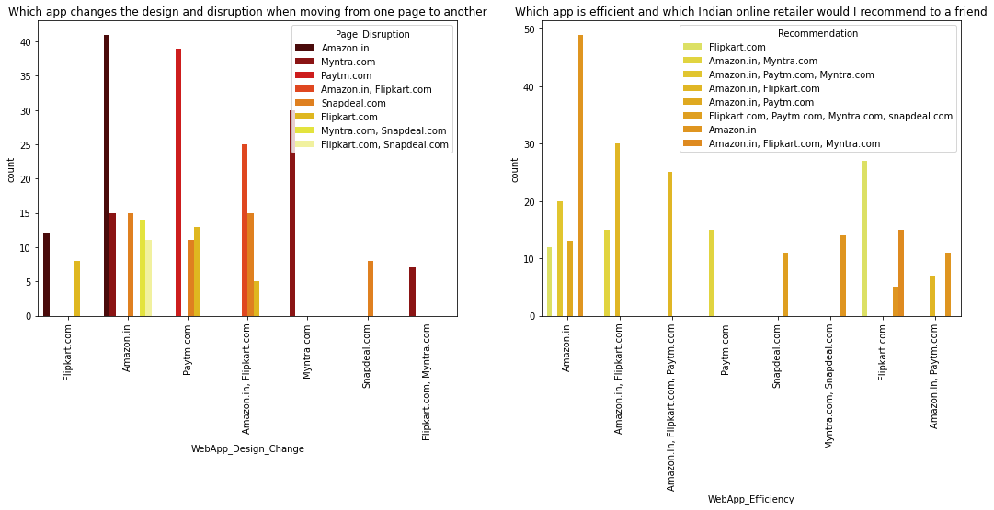

Slide 48
observation Amazon is the website where they frequently change their application designs in order to attract the customers and satisfies the customers’ needs and they tend to make customers by updating everyday as per the trend. But the disadvantages of this website are when moving from one page to other it slows down and sometimes it may shutdown. Amazon is the website which is more efficient as before and I suggest Amazon.com and Flipkart as a best Indian online retailer store for purchasing all types of products, as they provide enormous amounts of benefits.
Since we have observed all the columns contains object type data, so we need to convert them into numerical by using appropriate encding techniques. Here I am using label encoding method to convert the data.

Slide 49
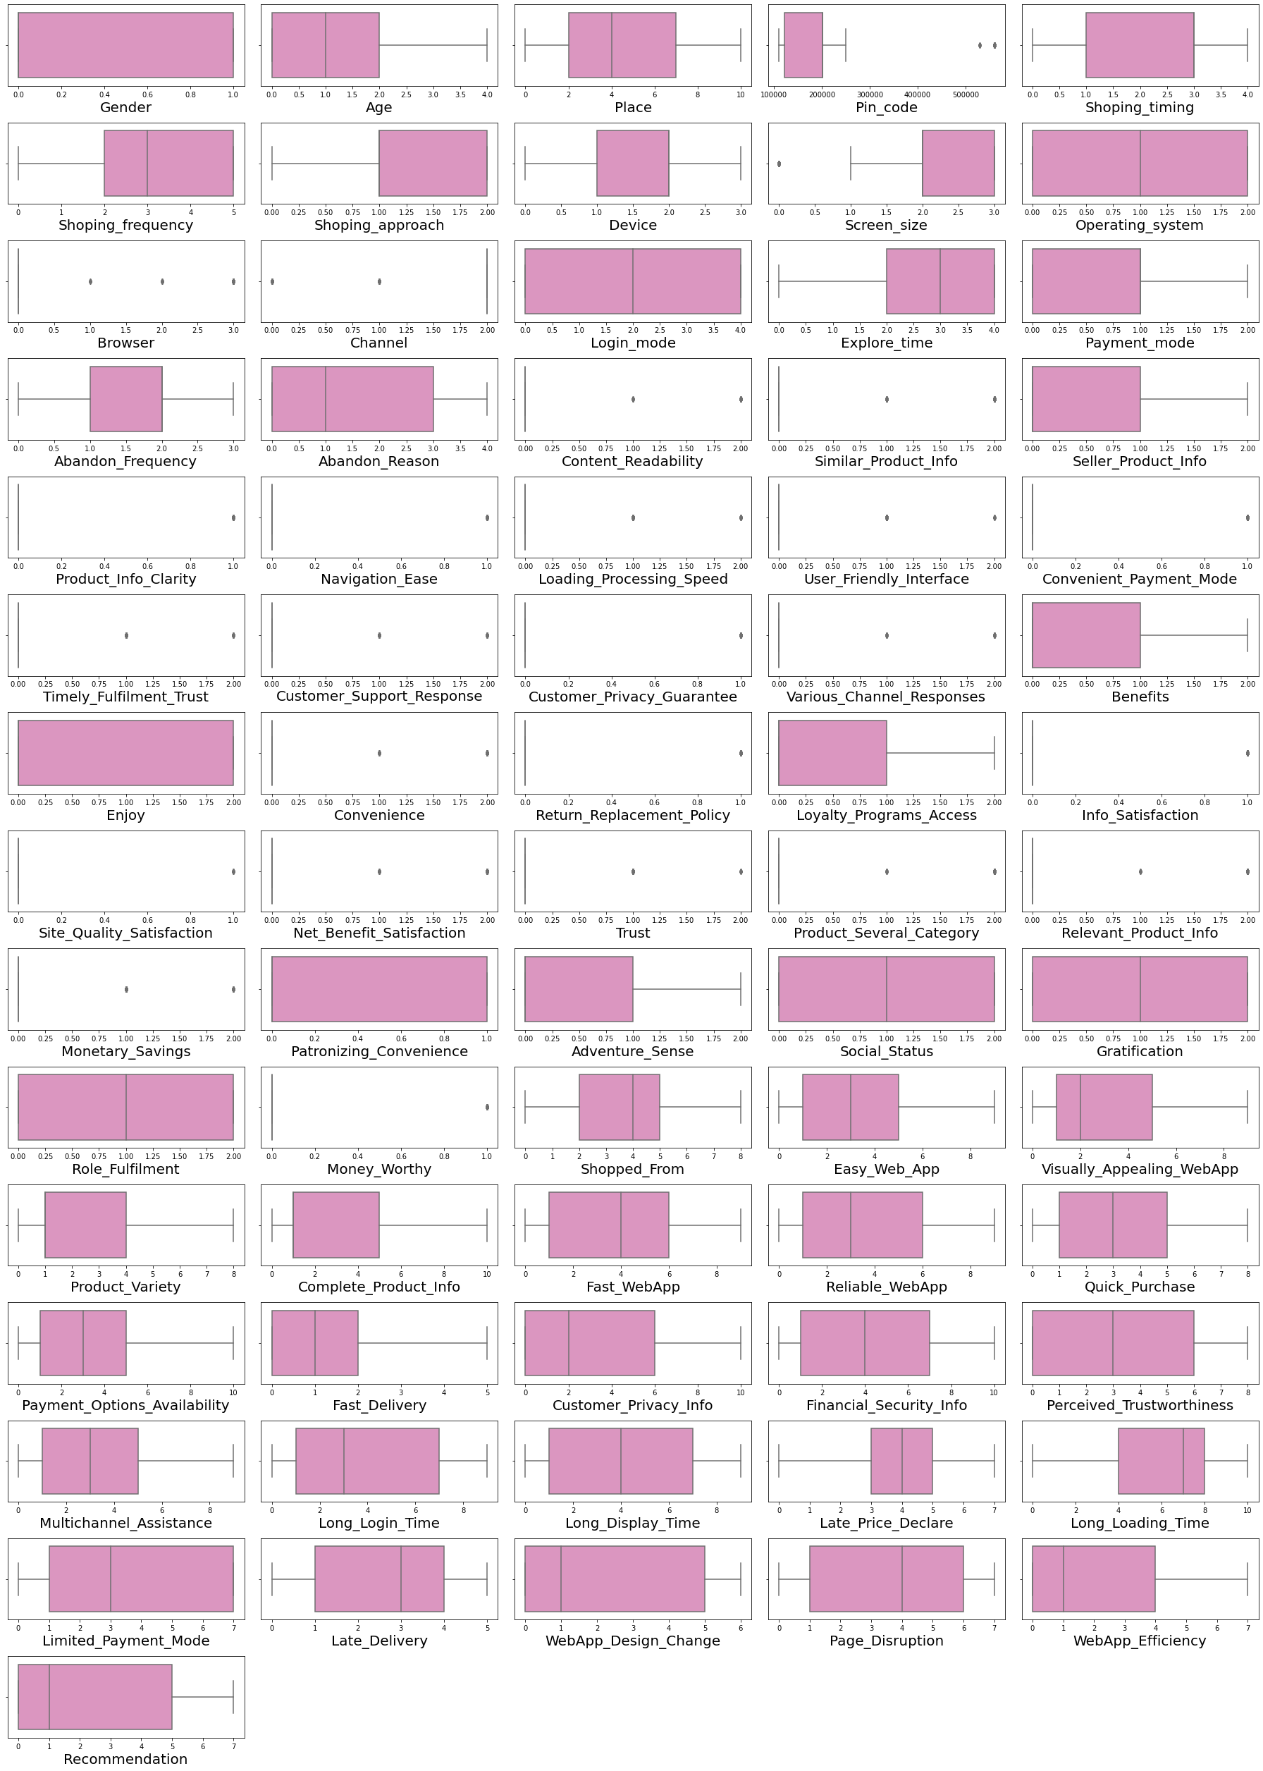

Slide 50
CONCLUSION
Key Findings and Conclusions of the Study:
Findings:
• In this project we have investigated ecommerce quality in online businesses and develop new knowledge to understand the most important dimensions of E-retail factor for customer activation and retention.
• This project aimed to enhance prior understanding of how ecommerce websites affected customer satisfaction, customer trust, and customer behavior, i.e., repurchase intention, customer loyalty, and site revisit.
• The dimensions like information about the products, convenient payment mode, Trust, Fulfilment, website design change, security/privacy and many others had a positive impact on the ecommerce websites for customers. Also, some of the dimensions like ease of navigation, loading and speed, late delivery etc. did not have impact on the ecommerce websites.

Slide 51
Conclusion of the Study
• The endeavor of this study is to identify the motivating factors towards online shopping and in which e-retailer the customers likely to shop more.
• In this project, I have done some feature engineering by replacing the unwanted entries by suitable values, found no null values, and renamed the columns by giving new names. Visualized the data using count plot, factor plot, pie plot and distribution plot, also encoded the object data into numerical using label encoding method. Checked the statistical summary of the dataset and checked for skewness, outliers and correlation between the features.
• From the analysis it was found that consumers purchasing decisions were dependent on various factors. All these motives motivate consumers to purchase products through online. According to consumers' opinions, "time saving" is the most important motivating factor for online shopping.

Slide 52
• Again "information availability", "open 24/7", "huge range of products/ brands", "reasonable prices", "various offers for online products", "easy ordering system", and "shopping fun" are other motivating factors for online shopping respectively. Also, "online payment system", "personal privacy or security issues", "delaying of delivery" and "lacks of personal customer service" are the main inhibitions of online shopping to the respondents.
• After visualizing the data, I found Amazon is the best online store where the customers trust on buying products and it has positive impact on the customers. Also, amazon and flip kart have increased customers’ expectations. So, they are the best online retailer who makes the loyal customers and satisfies the customers.
• It was also observed that online shopping is not trustworthy and reliable to some consumers due to only online payment system and personal privacy. In addition, online security is a major concern for the consumer particularly in terms of fraud, privacy and hacking. So, the organizers should make up their organization for better sales.

Slide 53
THANK
YOU

